Slide 1
Step by step using ClimMob v3
Author
Kauê de Sousa
Brandon Madriz Araya
06 March, 2020

Slide 2
Login or create an account
Create a project
Assign field agents
Select treatments
Prepare participants registration
Prepare data collection forms
Generate treatment packages and open registration of participants
Connecting your project with ODK Collect

Slide 3
Login or create an account

Slide 4
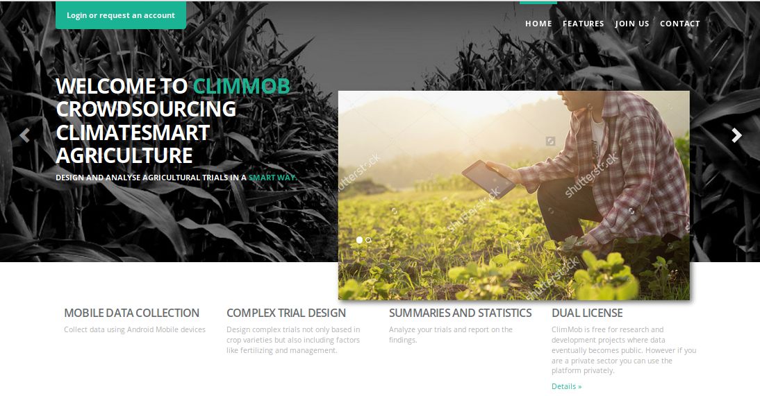
ClimMob (https://climmob.net/climmob3)

Slide 5
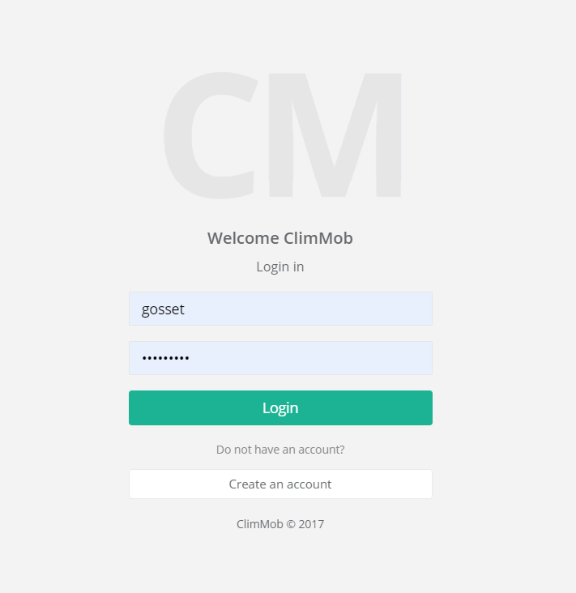
Login using your username and password, or create an account

Slide 6
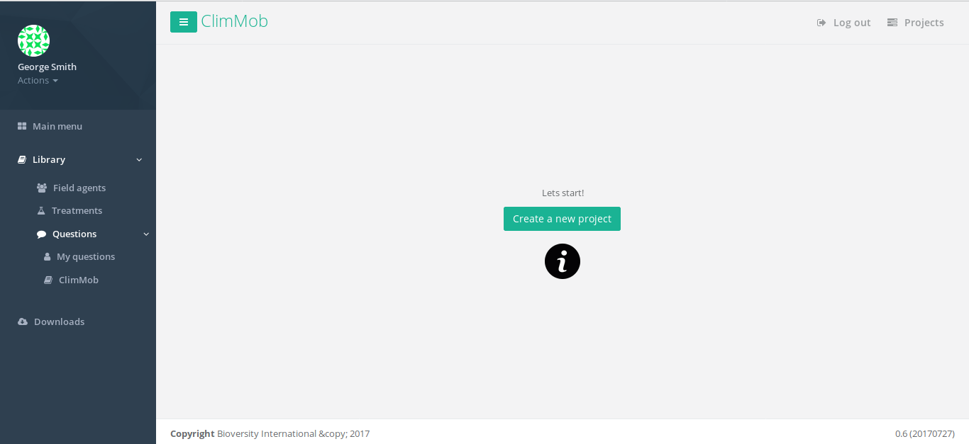
Here you see and manage your: Projects
Here you see and download your:
Packages codes (QR codes)
Randomization list Data

Slide 7
Create a project

Slide 9
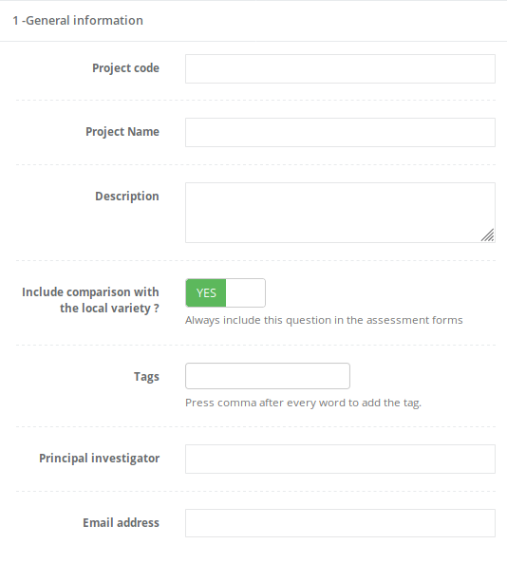
Here you add your project details

Slide 10
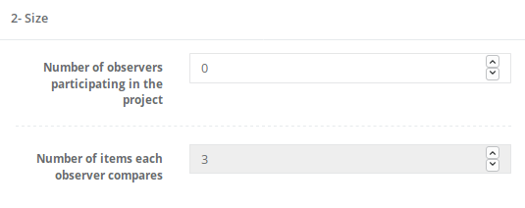
Here you add your trial details, such as the number of participants and how many items will be given to each participant

Slide 11
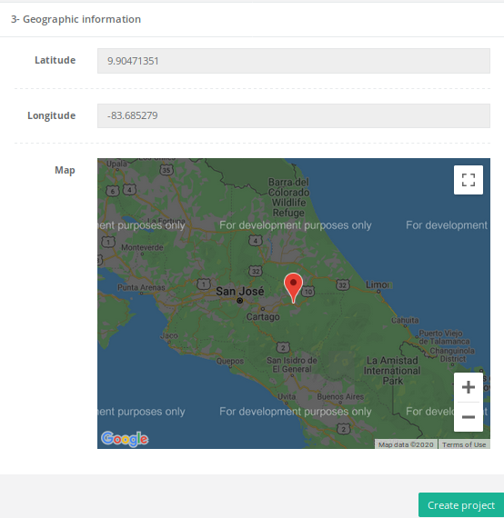
Here you add the geographic information.
After including all required information, press: “Create project”

Slide 12
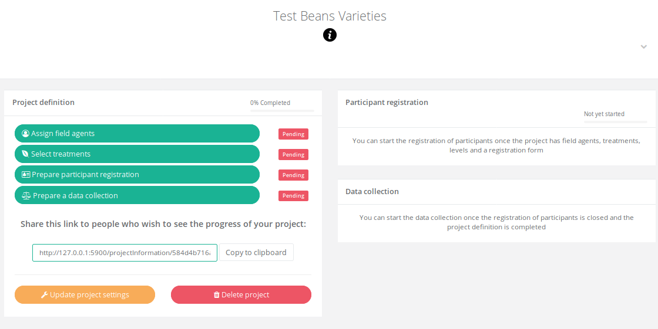
Dashboard

Slide 13
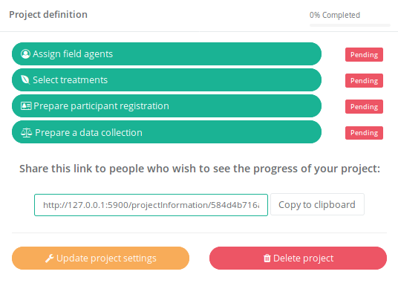
Here you assign Field Agents that will apply your survey(s) using ODK Collect

Slide 14
Here you add your treatments. Varieties (or technologies) that will be used in your project

Slide 15
Here you create the survey that will be used in the participants interviews using ODK Collect

Slide 16
Here you create the survey that that will be used in the data collection (check the performance of tested technologies)

Slide 17
Assign field agents
Here you will register, assign and manage the Field Agents that will collaborate in your project

Slide 19
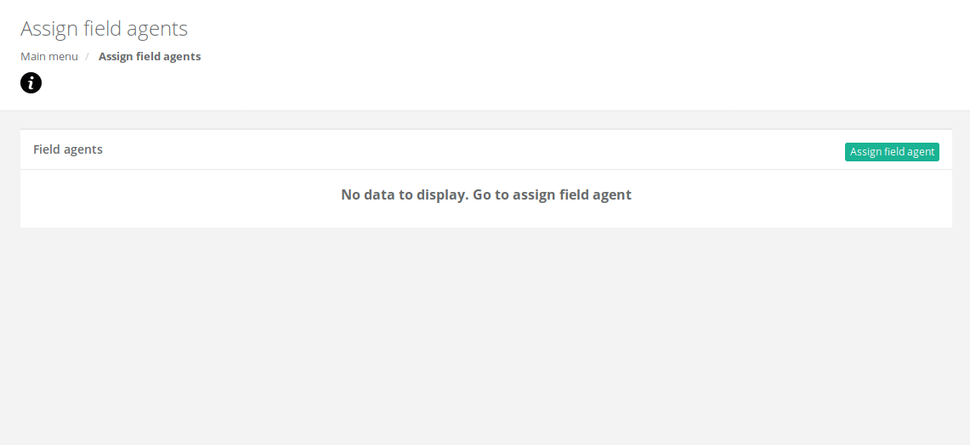
If you do not have any registered Field Agent, go to Library >> Field agents !

Slide 20
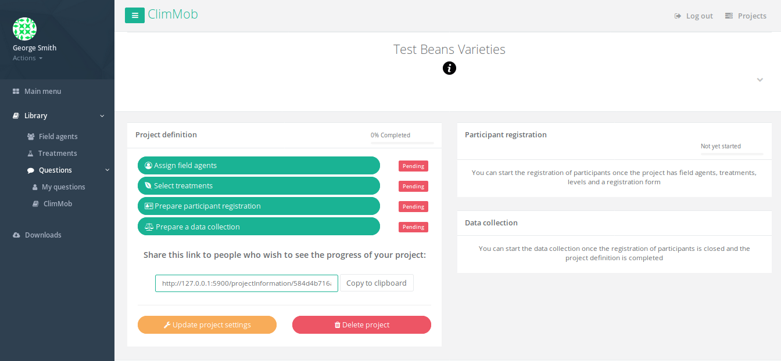

Slide 21
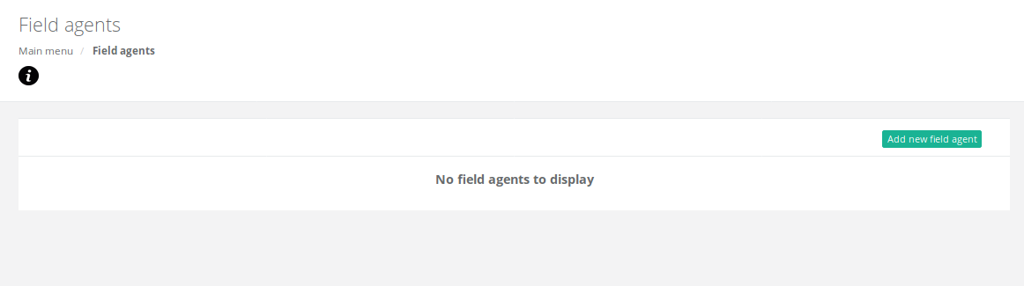

Slide 22
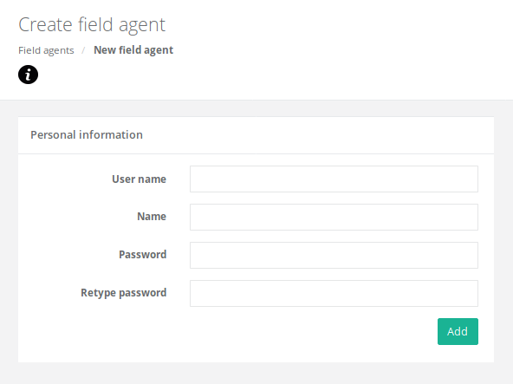
Add the user name and password that will be used to fetch survey using ODK Collect

Slide 23
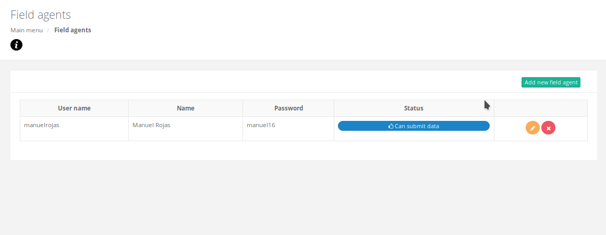
Add as many Field Agents as you like/want. You can manage it any time.

Slide 24
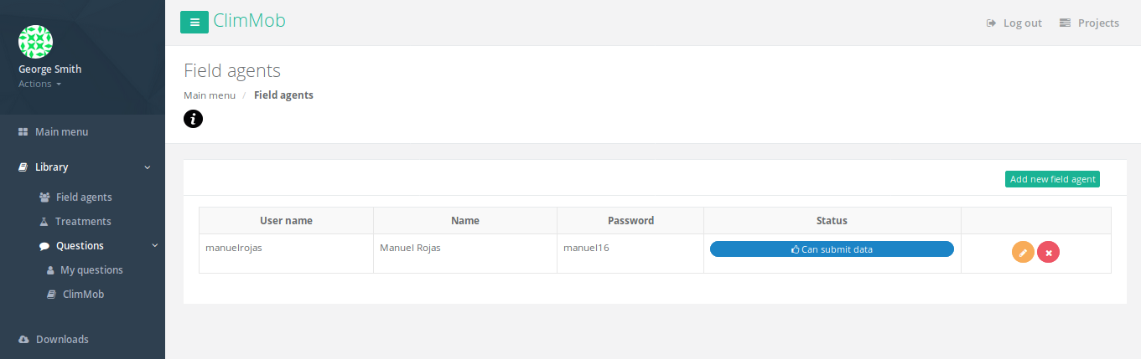
Return to the Main menu and assign your Field Agents

Slide 27
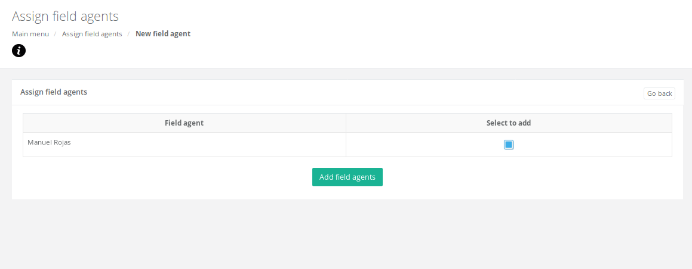

Slide 28
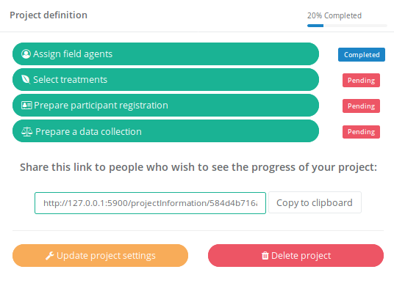
You have completed one step!

Slide 29
Select treatments
Here you will select/manage the technology and items (varieties) that will be tested in your project

Slide 30
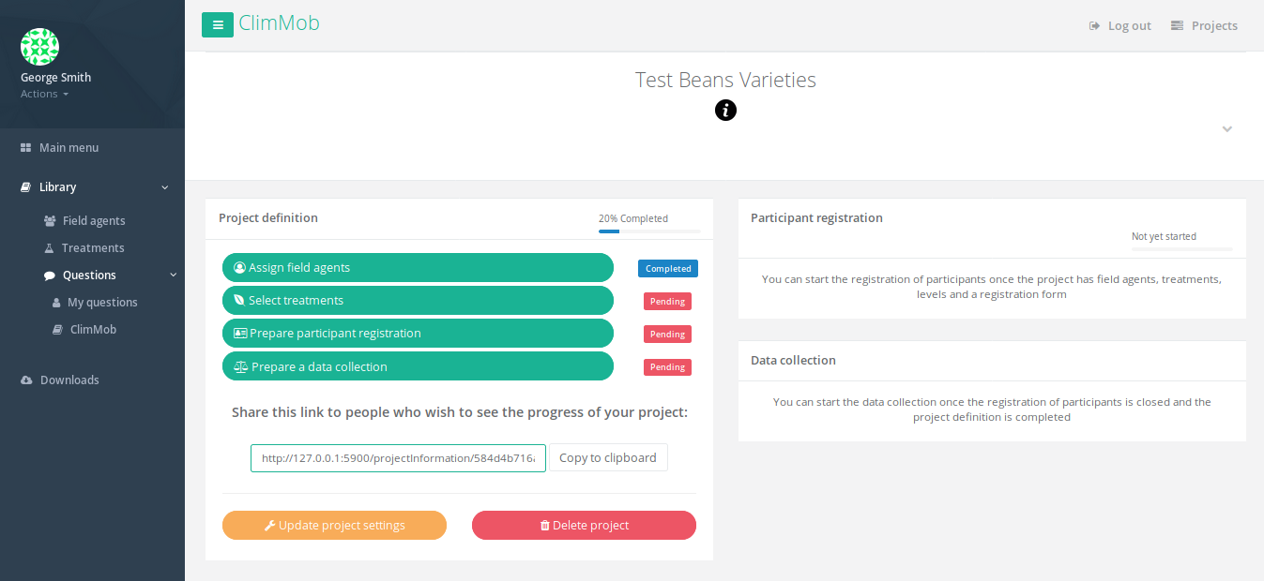

Slide 31
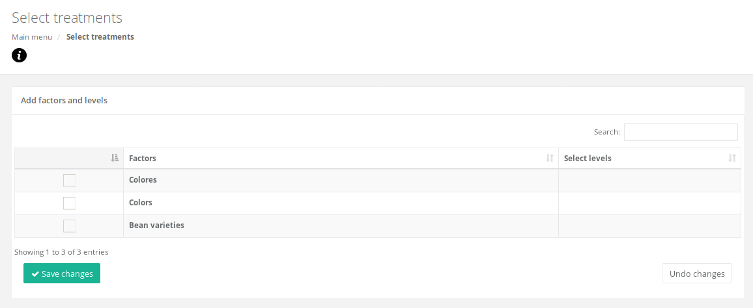
You can use one of the ClimMob samples or you can add a new technology in the Library >> Treatments

Slide 32
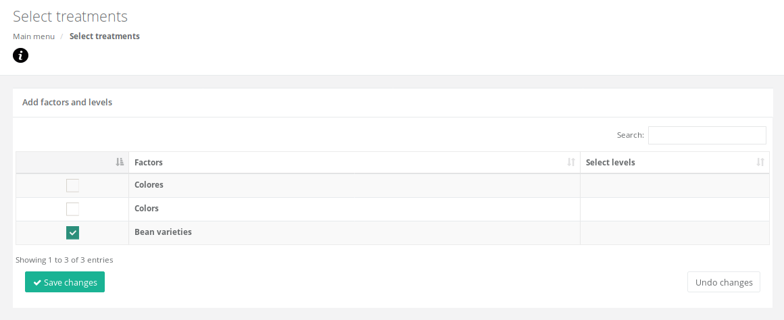

Slide 33
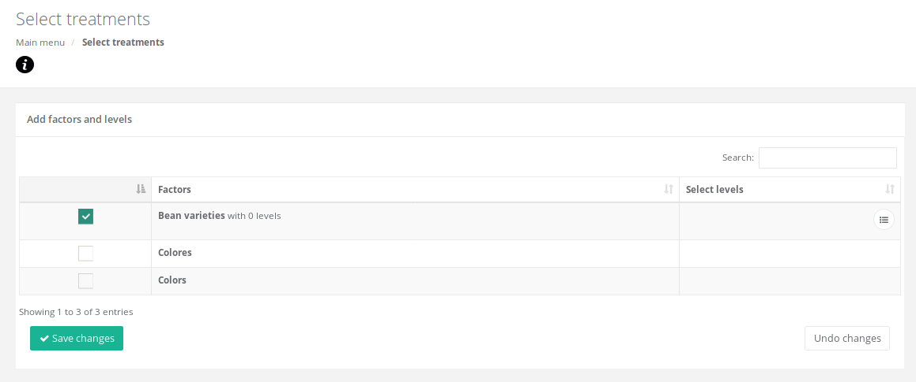
Here you add the varieties (or other levels) to your treatment

Slide 34
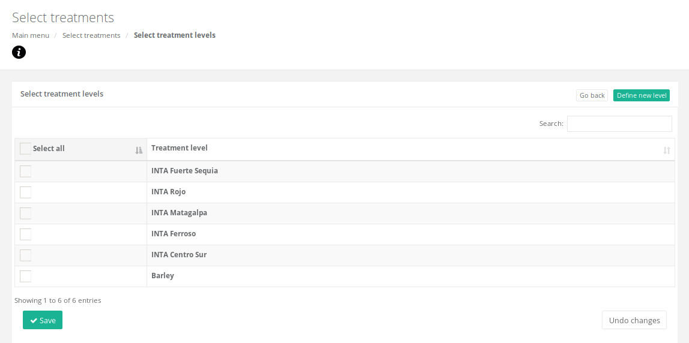
Add the varieties (items) that will be used in the trials
Here you can add new levels if needed

Slide 35
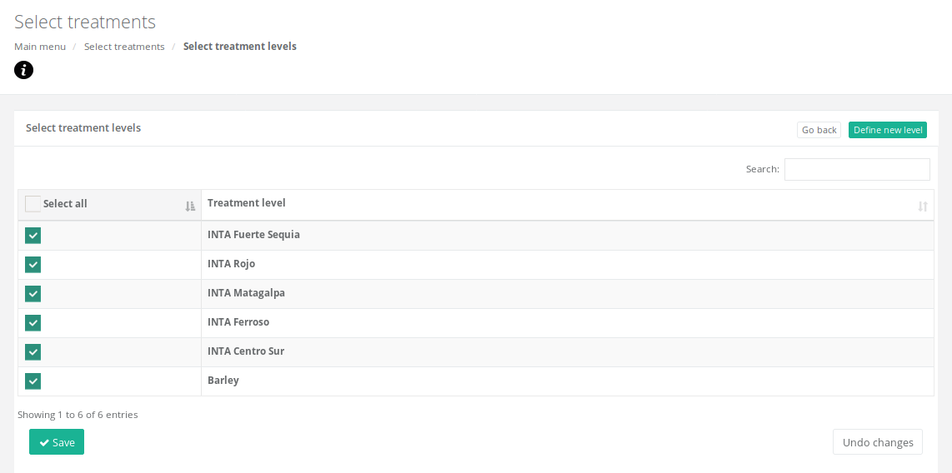

Slide 36
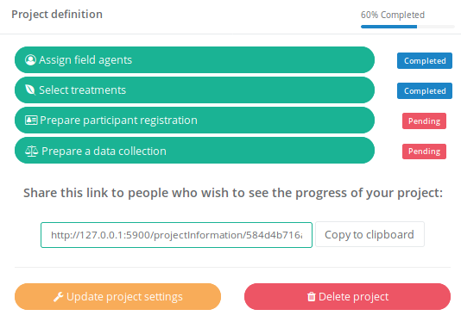
You have completed two steps!

Slide 37
Prepare participants registration
Here you will prepare/manage the survey that you be used to characterize the participants

Slide 38
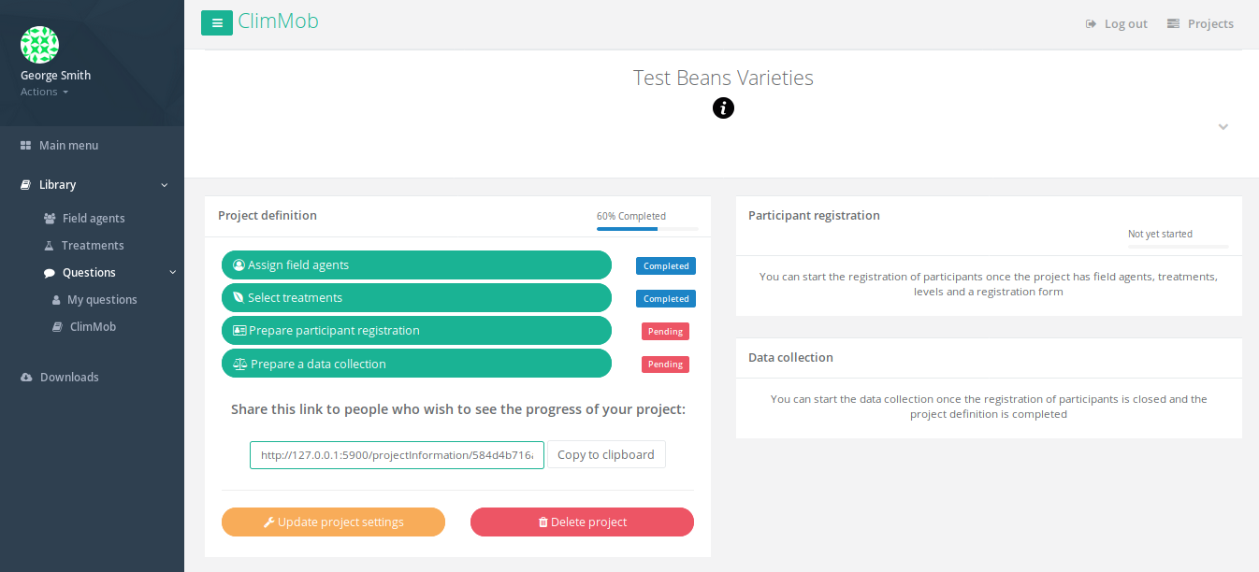

Slide 39
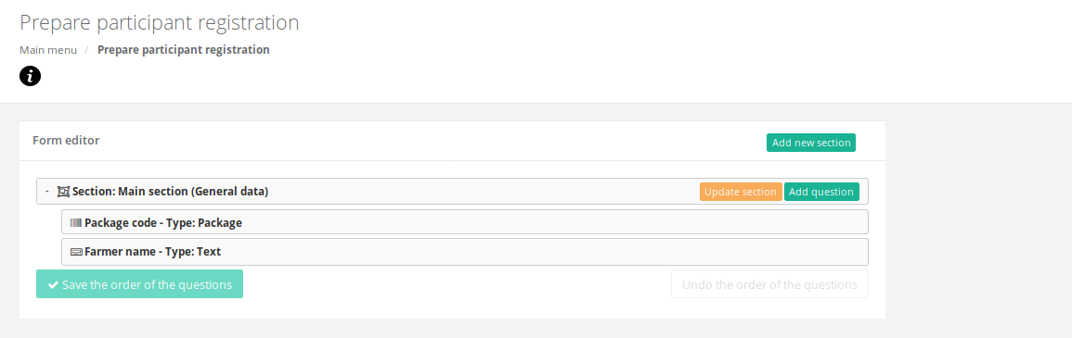
Here you add and manage the sections and questions in your participant registration. Each section is a page in you phone using ODK.

Slide 40
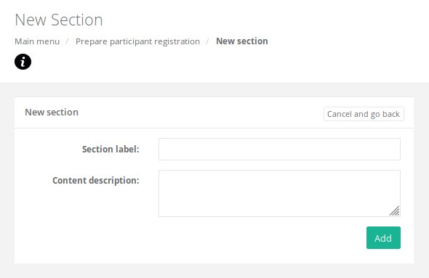

Slide 41
Add the name of this section and what will be done in it.

Slide 42
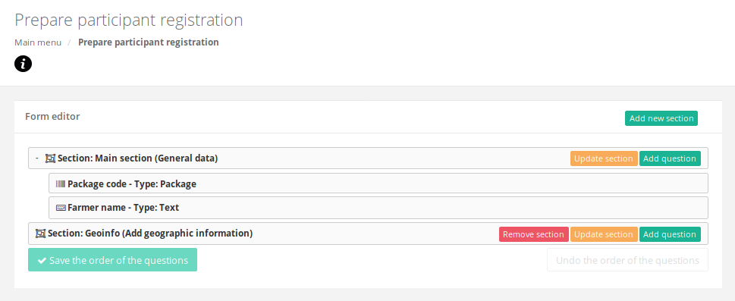
Add questions to your section

Slide 43
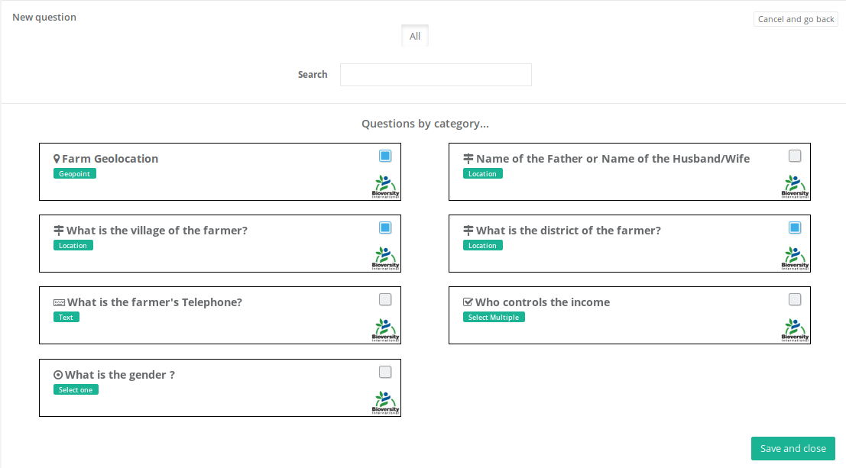

Slide 44
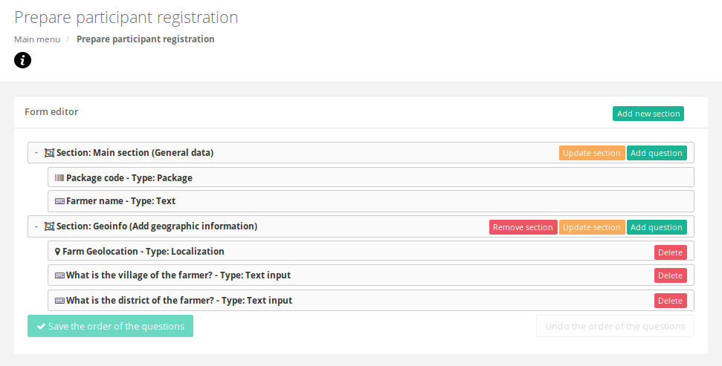

Slide 45
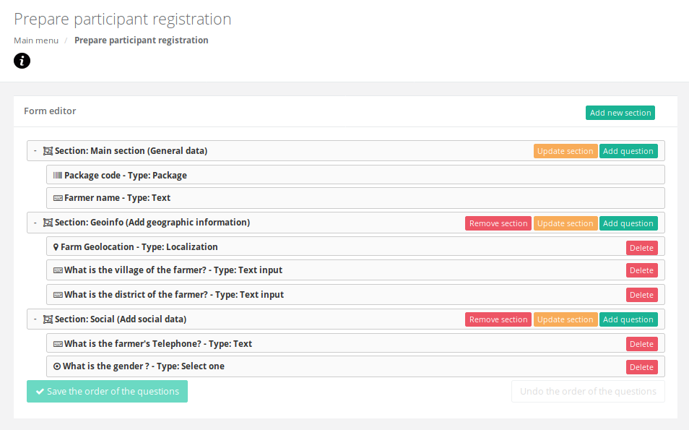
Adding social related questions, as an example. You can add new questions by going to Library >> My questions

Slide 46
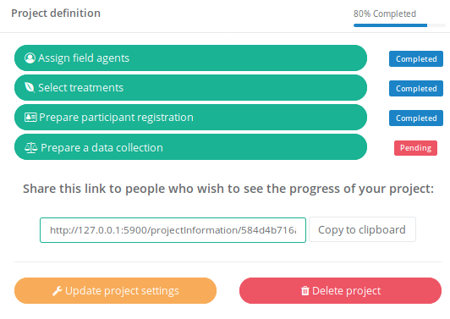
You have completed three steps!

Slide 47
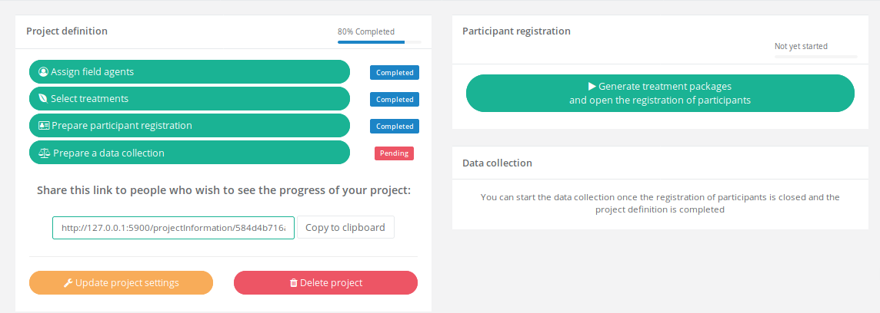
Now that you have done these steps, you can choose between:
Prepare the data collection and get participants evaluations
Generate the packages and open the registration of participants to your Field Agents
You decide which one goes first. But note that you and your Field Agents need to register your participants before go further with your data collection

Slide 48
Prepare data collection forms
Here you will prepare/manage the survey that you be used to collect the participants trial evaluation

Slide 49
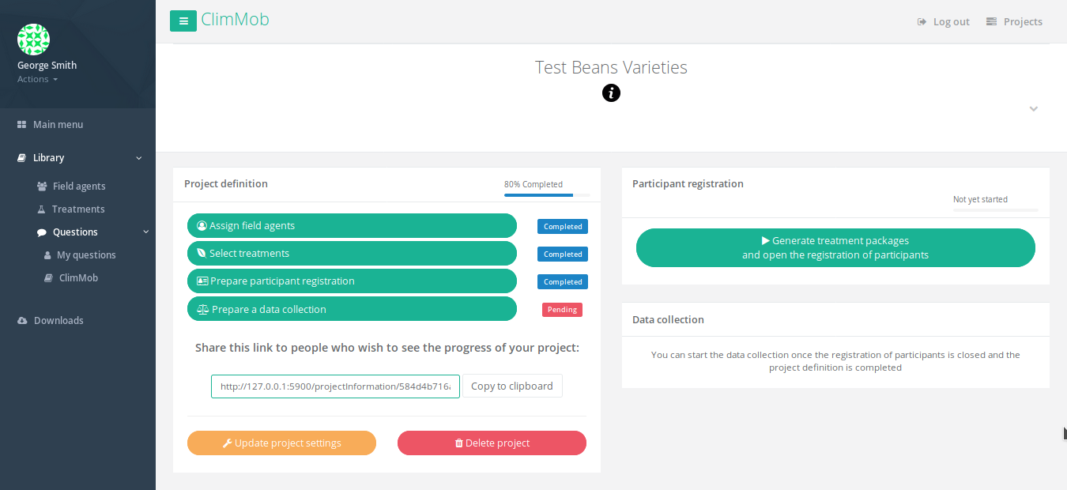

Slide 50
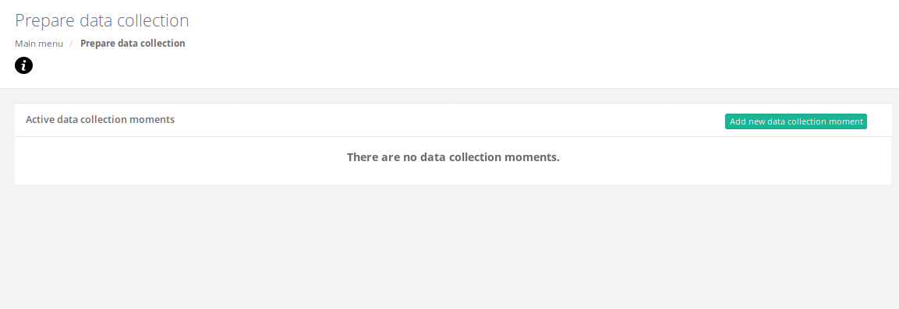
Here you choose in which step of your project the data collection will be made. For example, 30, 50 days after planting and the last data collection by the end of the trials

Slide 51
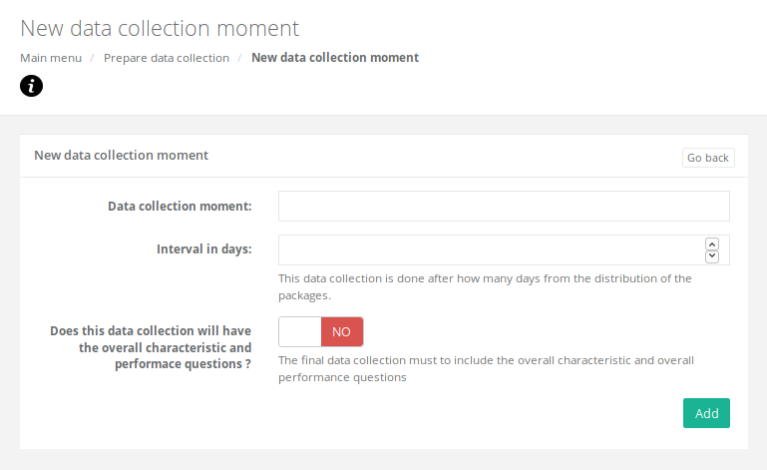
Complete all the information for the data collection moment

Slide 52
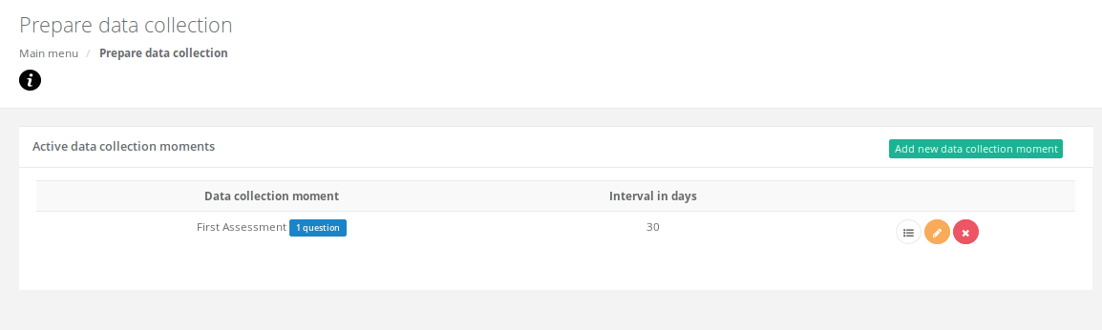

Slide 53
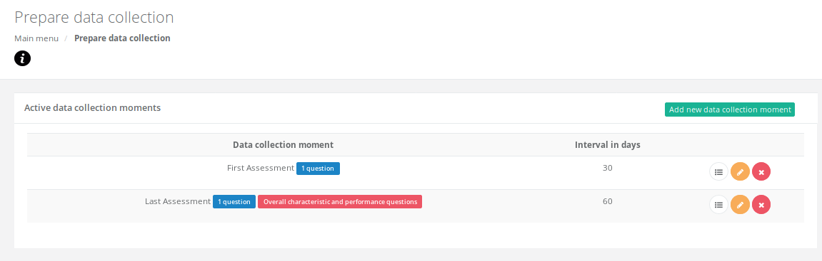
Press this to add the questions for each of data collection moment

Slide 54
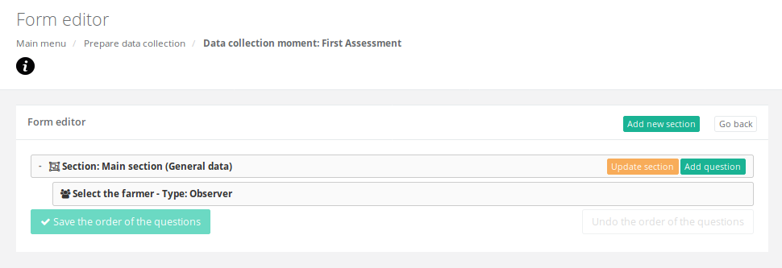

Slide 55
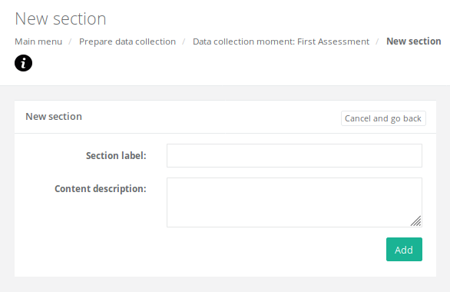
It is recommend that each section is a characteristic to evaluate

Slide 56
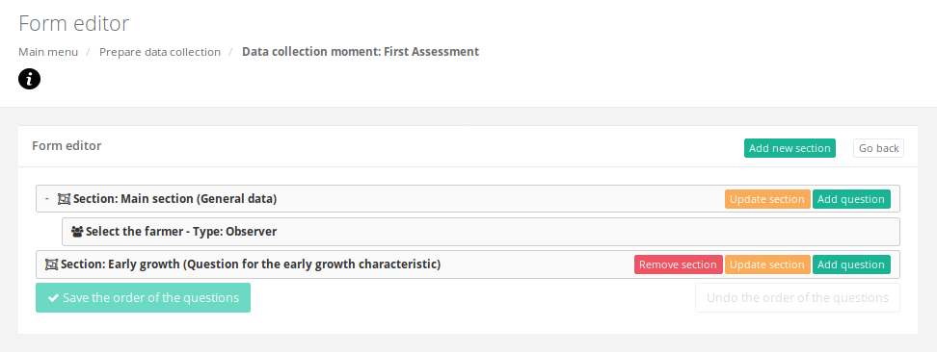
Add questions to this section. Questions about early growth are not available yet. They must be added in the Library

Slide 57
An example of adding a new data collection question

Slide 58
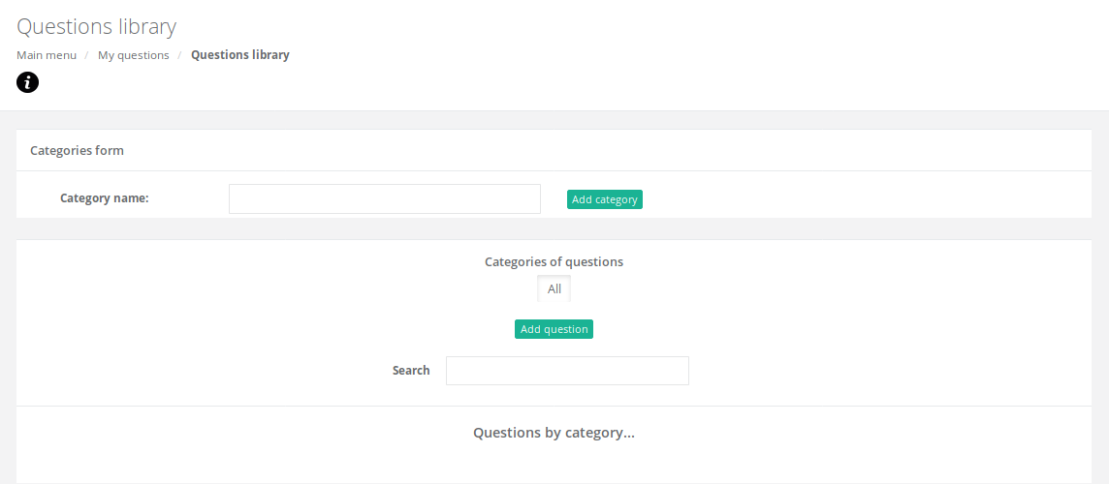
Create a categories for your questions

Slide 59
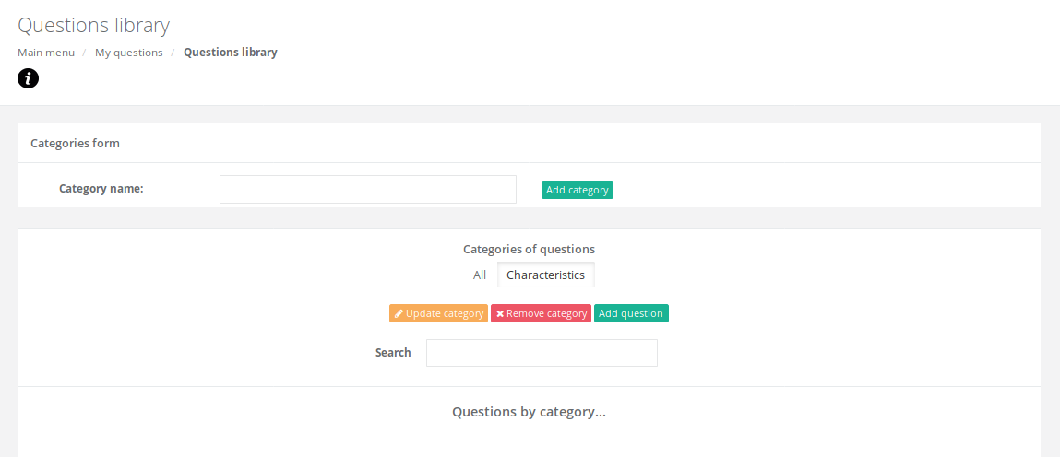
Select your category and click on add question

Slide 60
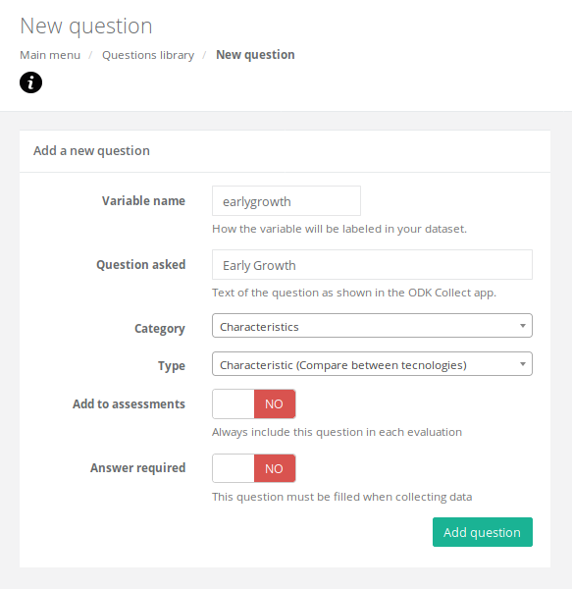

Slide 61
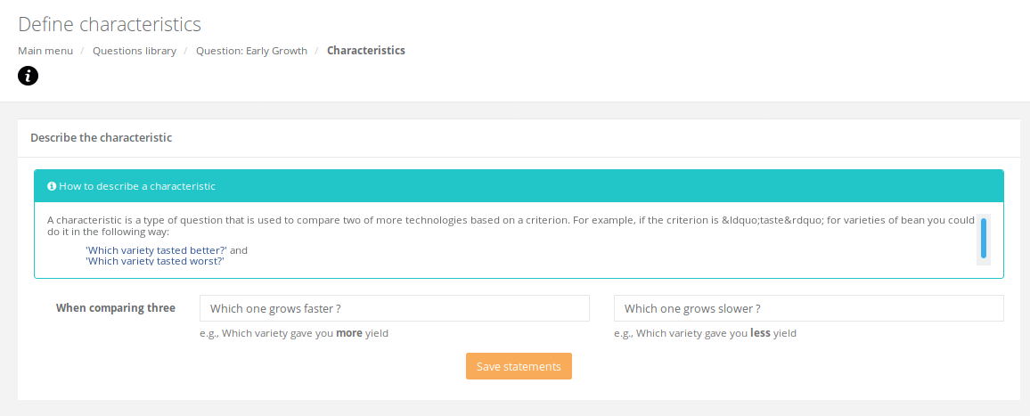
Type your questions for this characteristics depending on what kind of comparison will be used. It must be as short and clear as possible.

Slide 62
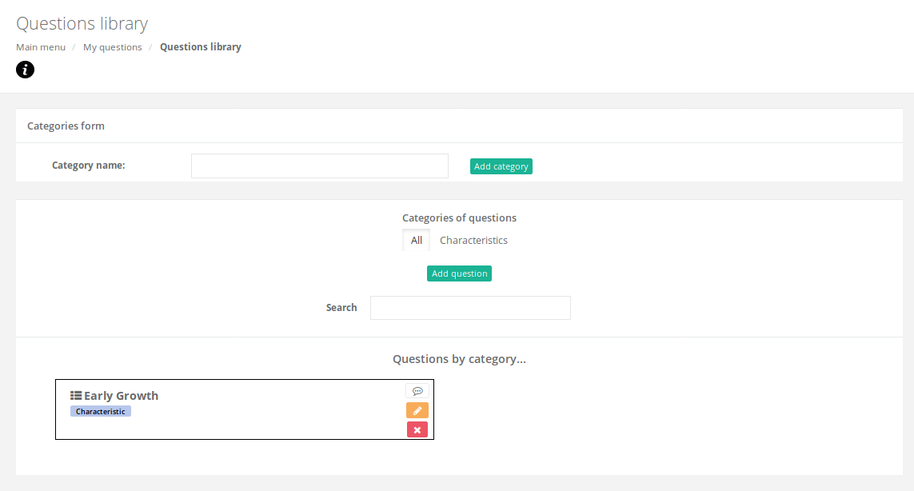
Your question is ready to be used.

Slide 63
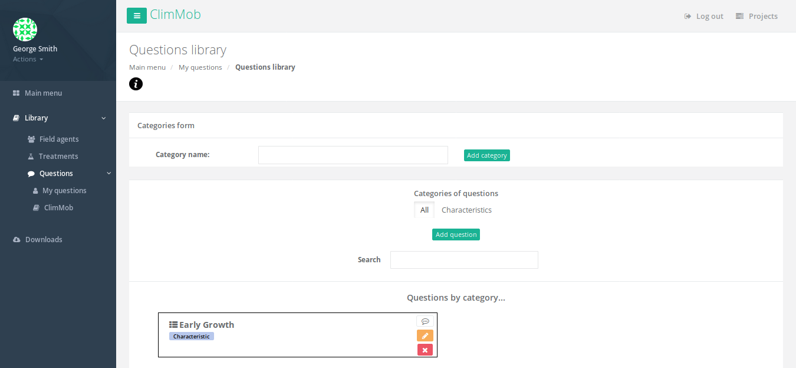
Return to the Main menu to prepare data collection

Slide 64
Continue with preparation of data collection
Add questions to this section

Slide 65
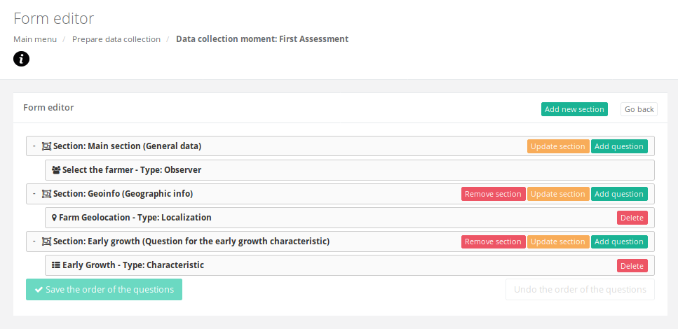
Add as many sections and questions you need. Then press
Note:
Generally farm geolocation is added in the first data collection moment

Slide 66

Also for the other data collection moments:

Slide 67
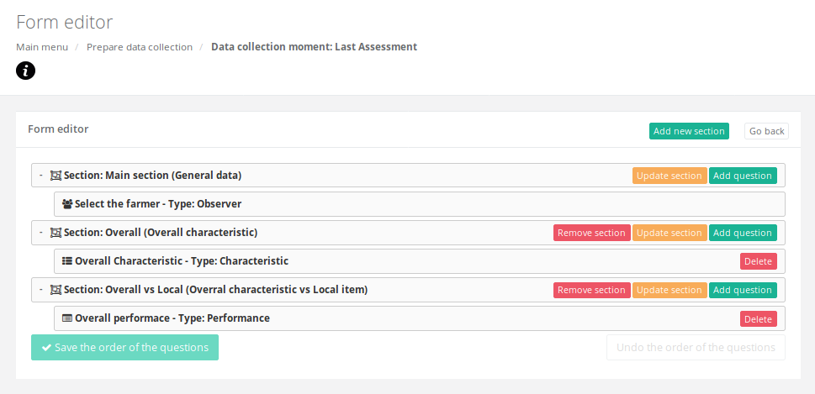
Generally the last data collection moment contain the questions related to the overall characteristics and, if desired, a comparison between the tested technologies with the Local item

Slide 68
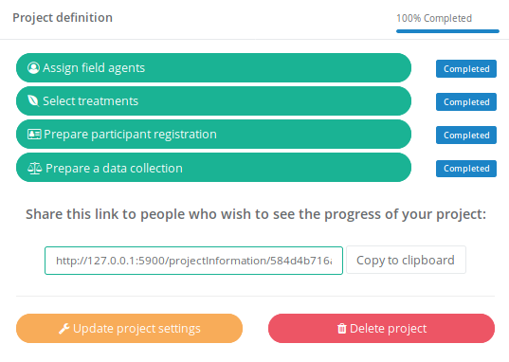
You have completed four steps!

Slide 69
Generate treatment packages and open registration of participants
Here you will generate the randomized treatment packages and open your registration survey to your Field Agents

Slide 70
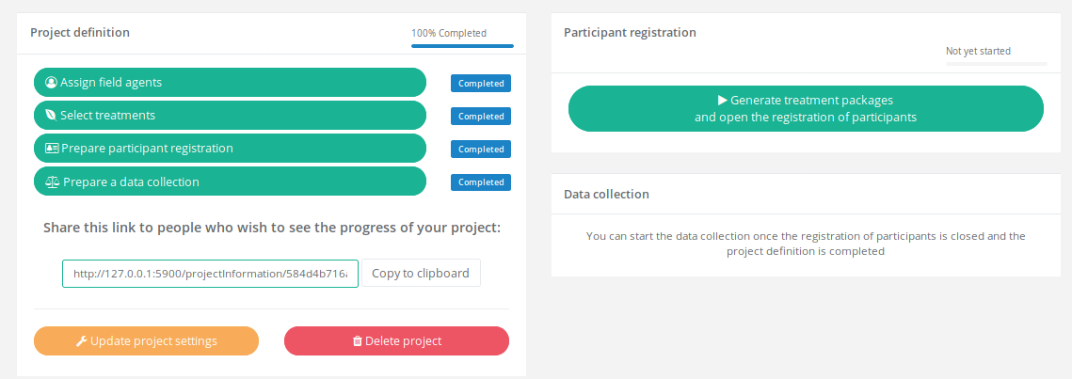

Slide 71


Slide 72


Slide 73

Now that your randomization is done your can get the packages information and run the registration of participants.

Slide 74

Go to Downloads to get the codes assigned to each package and the items that each one must have

Slide 75

The codes for each variety in each package
The randomization indicating where each variety were assigned
The QR codes for each package. To be used by Field Agents in the registration of participants
List of field agents with the QR to configure the ODK Collect

Slide 76

Cards.pdf

Slide 77

packages_testbeansvarieties.xlsx

Slide 78

packages_testbeansvarieties.pdf

Slide 79

fieldagents_testbeansvarieties.pdf

Slide 80
Connecting your project with ODK Collect
Here you and your Field Agents will connect your survey(s) with ODK

Slide 81


Slide 82

https://play.google.com/store/apps/details?id=org.odk.collect.android
Download the app in the Field Agent Android smartphone

Slide 83



In the Field Agent smartphone:

Slide 84

The field agents must scan their corresponding QR to configure the ODK Collect.

Slide 85

Here is your registration form!
Use the QR codes in the packages pdf to connect the packages info with your participants

Slide 86

Once you and your Field Agents have collected and submitted the registration forms the status of your project will change and you will be able to run your “data collection”

Slide 87
Thank you!
Author
Kauê de Sousa
Brandon Madriz Araya
k.desousa@cgiar.org
b.madriz@cgiar.org

